Slide 1
Introduction to Stata
Alicia Doyle Lynch
Harvard-MIT Data Center (HMDC)

Slide 2
Documents for Today
Find class materials at: http://libraries.mit.edu/guides/subjects/data/training/workshops.html
Several formats of data
Presentation slides
Handouts
Exercises
Let’s go over how to save these files together

Slide 3
Organization
Please feel free to ask questions at any point if they are relevant to the current topic (or if you are lost!)
There will be a Q&A after class for more specific, personalized questions
Collaboration with your neighbors is encouraged
If you are using a laptop, you will need to adjust paths accordingly

Slide 4
Organization
Make comments in your Do-file rather than on hand-outs
Save on flash drive or email to yourself
Stata commands will always appear in red
“Var” simply refers to “variable” (e.g., var1, var2, var3)
Pathnames should be replaced with the path specific to your computer and folders

Slide 5
Assumptions and Disclaimers
This is an INTRODUCTION to Stata
Assumes no/very little knowledge of Stata
Not appropriate for people already well familiar with Stata
If you are catching on before the rest of the class, experiment with command features described in help files

Slide 6
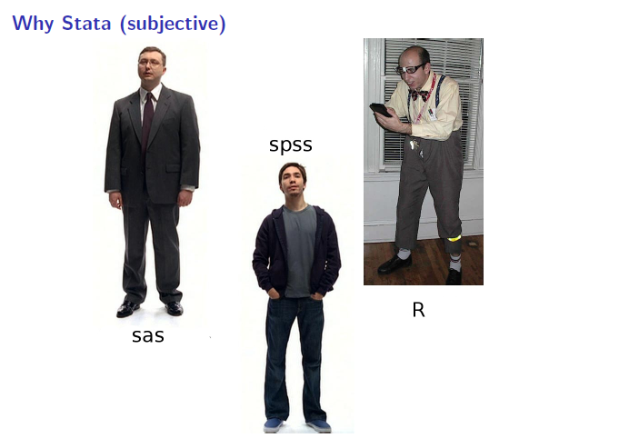
Why Stata?
If you know Stata, it is likely you will not need any other software packages
Used in a variety of disciplines
Great guides available on web (as well as in Dewey Library)

Slide 7
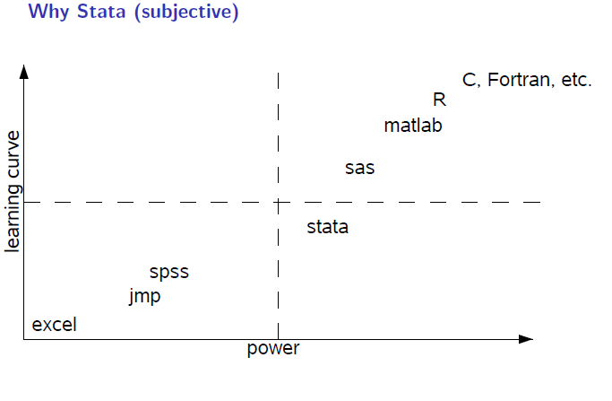
Why Stata?

Slide 8
Which Stata is right for you?
Package | Max. no. of variables | Max. no. of right-hand variables | Max. no. of observations | 64-bit version available? | Fastest: designed for parallel processing? | Platforms
Stata/MP | 32,767 | 10,998 | unlimited* | Yes | Yes | Windows, Mac (64-bit Intel), or Unix
Stata/SE | 32,767 | 10,998 | unlimited* | Yes | No | Windows, Mac, or Unix
Stata/IC | 2,047 | 798 | unlimited* | Yes | No | Windows, Mac, or Unix
Small Stata | 99 | 99 | 1,200 | No | No | Windows (32-bit) or Mac (32-bit)

Slide 9
How do I get Stata?
Your Department IT
Athena terminals at MIT
HMDC labs
Buy it: educational or grad plan
http://libraries.mit.edu/guides/subjects/data/software/index.html

Slide 10
Opening Stata
Open a terminal and type
add stata
xstata
Stata should come up on your screen
Always open Stata FIRST and THEN open Do-Files (we’ll talk about these in a minute), data files, etc.

Slide 11
Stata Interface
Comprised of four windows:
Results
Command
Review
Variables
Review and Variable windows can be closed (user preference)
Command window can be shortened (recommended)

Slide 12
Do-Files
A fifth window, called a “Do-file” is also important
Open Do-File via icon or with dropown menu
You can type all the same commands into the Do-File that you would type into the command window
BUT…the Do-file allows you to SAVE your commands
Your Do-file should contain ALL* commands you executed
*at least all the “correct” commands!

Slide 13
Command Window vs. Do-File
I recommend never using the command window
Saving commands in Do-File allows you to keep a written record of everything you have done to your data
Allows easy replication
Allows you to go back and re-run commands, analyses and make modifications

Slide 14
Let’s get started
Open up a new Do-File
Before we do anything, we need to tell Stata how much memory to use
set mem 500m, perm
“Perm” makes this permanent (everytime you open Stata, it will allow 500m of memory)

Slide 15
Opening Files in Stata
Look at bottom left hand corner of Stata screen
This is the directory Stata is currently reading from
We can also see this by typing pwd in our Do-File editor
Use dir to see what is in the directory
If your datafile is not there, Stata will not open it!

Slide 16
Opening Files in Stata
When I open Stata, it tells me it’s using the directory:
afs/athena.mit.edu/a/d/adlynch
But, my files are located in:
afs/athena.mit.edu/a/d/adlynch/IntroStata
I’m going to tell Stata where it should look for my files:
cd “~/IntroStata”

Slide 17
A Note About Path Names
If your path has no spaces in the name (that means all directories, folders, file names, etc. can have no spaces), you can write the path as is
If there are spaces, you need to put your pathname in quotes

Slide 18
Data File Commands
Once we use the cd command to set the pathname, we no longer have to worry about the path
Retrieving your data file:
use datasetname.dta
Saving your data file:
save datasetname.dta
This command should be followed by “, replace” if you’re writing over an existing file

Slide 19
Where’s my data?
Data editor (browse)
Data editor (edit)
Never use!
Always keep any changes to your data in your Do-file
Avoid temptation of making manual changes by viewing data via the browser rather than editor

Slide 20
Creating a Log File
A log file is a recording of your Stata session
Basically, it’s saving a copy of your results window
To create a log file:
log using logname
If you’re writing over an existing log, this command should be followed by “, replace”

Slide 21
How to Start Every Do-File
1. Set memory
2. Call up dataset
3. Begin log file
/*DESCRIPTION OF FILE*/
set mem 500m
use datasetname.dta
log using logname

Slide 22
Stata Help
Easiest way to get help in Stata – just type “help” followed by topic
help regress
“Search” also works – but is less specific
Generally, if you google “Stata [topic],” you’ll get some helpful hits
UCLA website: http://www.ats.ucla.edu/stat/Stata/

Slide 23
General Stata Command Syntax
Most Stata commands follow the same underlying principles
Command variable(s), options
sum var1 var2, detail
CAUTION – in some cases, if you type a command and don’t specify a variable, Stata will perform the command on all variables in your dataset
You can find command-specific syntax in the help files

Slide 24
General Stata Command Syntax
Always label your Do-file immediately
Use comments throughout
Stata needs to be told what is a comment and what is a command:
*comment
/*comment comment comment comment comment comment comment comment*/

Slide 25
What if my data is not a Stata file?
Delimited, ASCII (text file)
insheet using gss.csv, clear
outsheet using gss_new.csv, replace comma
Stata will open SAS transport files
fdause gss.xpt

Slide 26
What if my data is from another statistical software program?
SPSS/PASW will allow you to save your data as a Stata file
Go to: file > save as > Stata (use most recent version available)
Then you can just go into Stata and open it
StatTransfer

Slide 27
What if my data is in excel?
You can copy and paste your excel file directly into Stata’s data editor
You need to make sure that all of your columns have labels
After you paste, you will see a prompt asking, “Is the first row data or variable names?”
Select “treat first row as variable names”
Or, if you save as .xml use syntax:
xmluse gss.xml, doctype(excel) firstrow

Slide 28
Exercise 1: Importing Data

Slide 29
Descriptive Statistics
Review your data carefully
describe
sum
codebook
list
tab
Remember, if you run these commands without specifying variables, Stata will produce output for every variable

Slide 30
Once you have successfully imported
View data visually with a histogram
hist varname
Interested in normality of your data? You can as Stata to draw the normal curve over your histogram
hist varname, normal

Slide 31
Variable and Value Labels
You never know why and when your data may be reviewed
ALWAYS label every variable no matter how insignificant it may seem
Stata uses two sets of label commands
1. variable labels
2. value labels

Slide 32
Variable and Value Labels
Label variable hh_inc “household income”
la var inc “household income”
Want to change the name of your variable?
rename oldvarname newvarname

Slide 33
Variable and Value Labels
Value labels are labels you put on the values that variables take on (e.g., “yes,” “no,” “1,” “2,” “3”)
Value labels are a two step process:
1. “define” a value label
2. Assign defined label to variable(s)

Slide 34
Variable and Value Labels
Let’s define a value label for yes/no responses
la define example 1 “Yes” 0 “No”
Stata knows what our label means, but now we need to assign it to variable(s)
la val var1 var2 var3 example
Label define useful when you have multiple variables with the same value structure
Less useful when you have only one variable with the corresponding value structure
If you have many variables, you can search labels using: lookfor
lookfor income

Slide 35
Exercise 2: Variable Labels and Value Labels

Slide 36
Data Manipulation Commands
After ensuring variables were correctly imported you may wish to create new variables or modify existing variables
NEVER delete or write over an original variable

Slide 37
Useful Data Manipulation Commands
== equal to (status quo)
= used in assigning values
!= not equal to
> greater than
>= greater than or equal to
& and
| or

Slide 38
Data Manipulation Commands
Creating a new variable? Start off with “gen” command
gen newvar = .
This creates a new, blank variable space
Next, start adding your qualifications
replace newvar=1 if var1==2
replace newvar=2 if var1==2 & var2==2
replace newvar=3 if var1==2 | var2==2

Slide 39
Data Manipulation Commands
Recoding variables
recode varname (1=2) (2=3)
Deleting variables
drop varname
Keeping a subset of variables
keep var1-varn

Slide 40
The “By” Command
Sometimes, you’d like to generate output based on different categories of a single variable
For example, say you want to look at happiness based on whether an individual is male or female
The “by” command does just this
bysort sex: tab happy
hist happy, by(sex)

Slide 41
Exercises 3 & 4

Slide 42
Other Services Available
MIT’s membership in HMDC provided by schools and departments at MIT
Institute for Quantitative Social Science
www.iq.harvard.edu
Research Computing
www.iq.harvard.edu/research_computing
Computer labs
www.iq.harvard.edu/facilities
Training
www.iq.harvard.edu/training
Data repository
http://libraries.mit.edu/get/hmdc

Slide 43
Thank you!
All of these courses will be offered during MIT’s IAP and again at Harvard during the Spring 2011 semester.
Introduction to Stata
Data Management in Stata
Regression in Stata
Graphics in Stata
Introduction to R
Introduction to SAS
Sign up for MIT workshops at: http://libraries.mit.edu/guides/subjects/data/training/workshops.html
Sign up for Harvard workshops by emailing: dataclass@help.hmdc.harvard.edu

